Slide 1
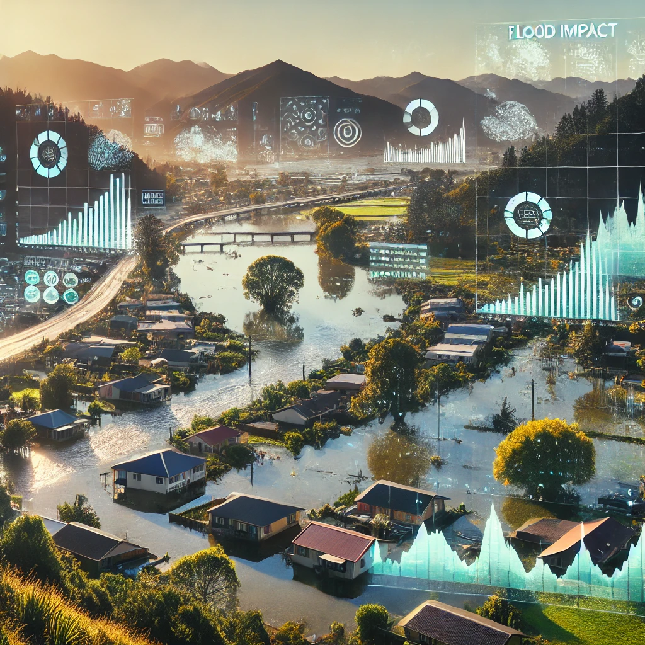




Extracting Historical Flood Impacts From Unstructured Data Using Large Language Models
Research Internship: CrisisLab, JCDR, Massey University
Presenter: Vajiranath Sudusinghe
Date: 31-JUL-2025
Notes:
Slide 1 – Title & Introduction (1 min 30 sec)
Hello everyone.
My name is Vajiranath Sudusinghe. I’m from Sri Lanka, and I recently finished my Master’s in Applied Data Science at the University of Canterbury.
This is my internship research project:
“Extracting historical flood impacts from unstructured data using Large Language Models.”
Now, some of you may not be from a technical background. So let me explain two quick things.
Unstructured data means data that is not organized—like newspaper articles, where useful information is hidden in long text.
Large Language Models or LLMs—like ChatGPT—are powerful AI systems.
They can understand language, summarize it, and even extract useful facts.
In this project, I used these tools to collect and organize information about past flood events in New Zealand.

Slide 2
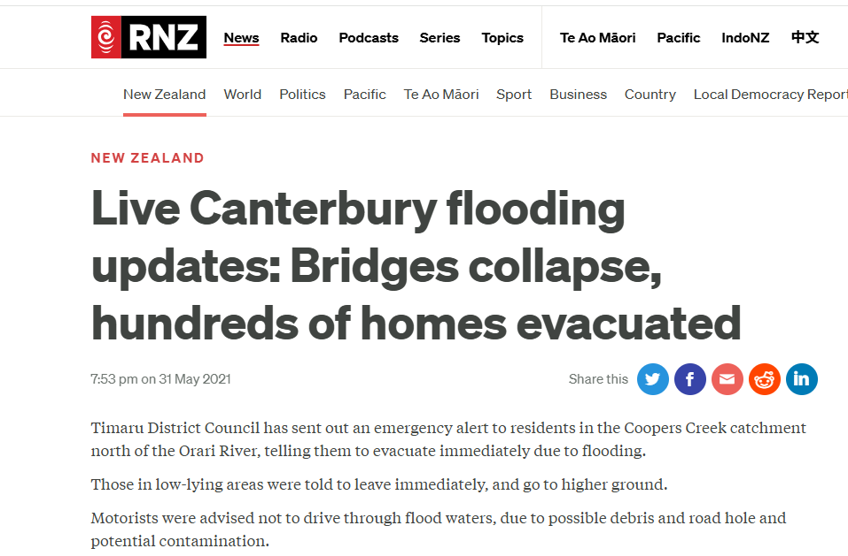
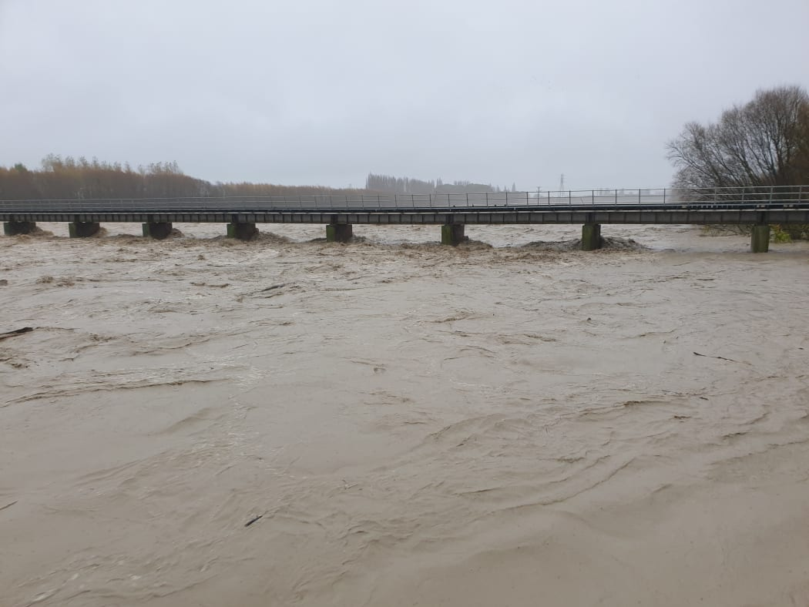
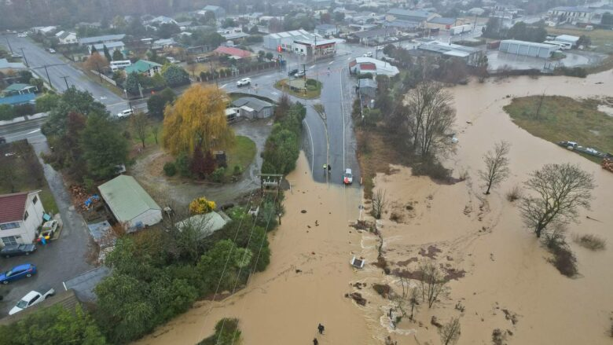
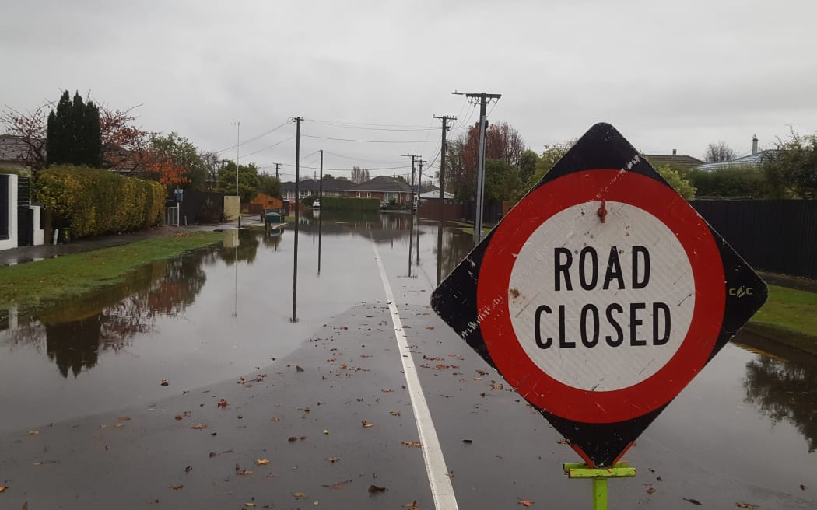
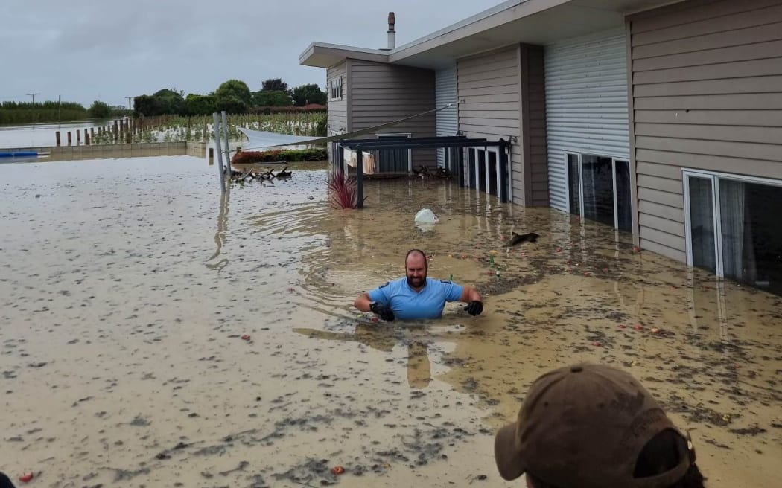
Flood Impacts Datasets in New Zealand
Objective:
Develop a comprehensive dataset of historical flood impacts linking to weather events
Notes:
Slide 2 – Why This Project? (2 min)
Floods are one of New Zealand’s most common and serious natural disasters.
After a flood, we often want to ask:
What areas were affected?
What kind of damage happened?
When did it occur?
But there is no single place to find all this information.
The data is scattered—in newspapers, local websites, and reports.
This makes it hard for emergency teams and government agencies to learn from the past.
That’s why our goal was to build a central dataset of past flood impacts.
For each flood, we wanted to find:
The date,
The location,
And the type of impact—like homes flooded or roads closed.
We used NIWA’s weather event records to identify the major flood events.

Slide 3
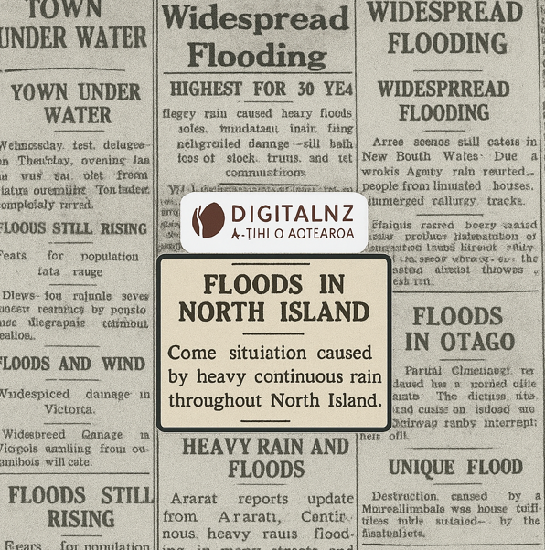




Methodology
Historical Flood News Articles
Historical Weather Events Data
Flood Impact Dataset
Notes:
Slide 3 – How We Did It (1 min 30 sec)
To collect the articles, we used a tool called DigitalNZ.
This is a service by the National Library of New Zealand.
It contains archives of old newspapers, magazines, and documents.
We used their API to search and download articles related to floods.
Then we used ChatGPT, a Large Language Model, to read these articles and extract information.
For example, the AI looked at a news article and found things like:
The date of the flood,
The region, and
The description of the impact.
We also checked these outputs with NIWA data, to confirm the event and location.

Slide 4
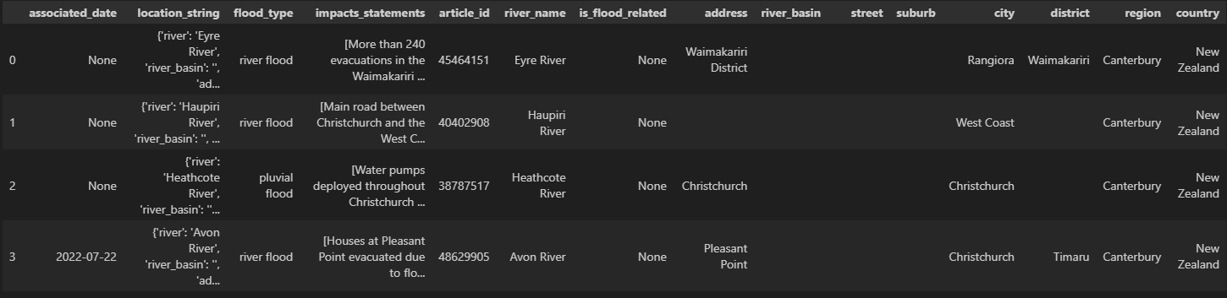
Results
Impact statements
"{""Almost the entire town of 1600 people was evacuated after the Rangitāiki River burst its banks."",""Residents will need ongoing support for some time."",""Floodwaters surged through the town after days of heavy rain that caused flooding"",slips,""power cuts and road closures.""}"
LLM Output
Location String
"{'river': None, 'river_basin': None, 'address': None, 'street': None, 'suburb': None, 'city': 'Christchurch', 'district': None, 'region': 'Canterbury', 'country': 'New Zealand'}"
Structured locations
Notes:
Slide 4 – Organizing the Data (45 sec)
The AI gave its answers in a format called JSON—which is like structured text that computers understand.
I stored these in a PostgreSQL database.
For example, I stored the impact statement, and also separated fields like the location, event date, and type of impact.
This made the data searchable and easy to analyze.

Slide 5
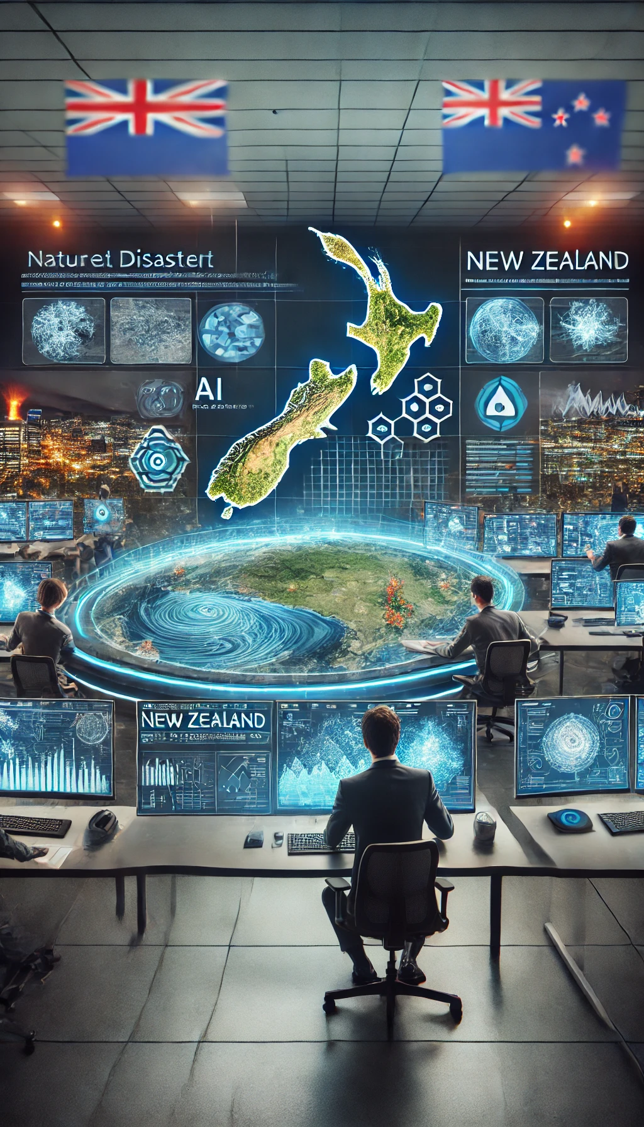
Key Takeaways & Next Steps
Python-powered ETL
Real-world application of LLMs
Prompt engineering best practices
Geotagging and spatial data integration
Scaling capabilities
Notes:
Slide 5 – Key Takeaways (1 min 15 sec)
There are four main things I learned:
It is important to build a flood impact dataset for New Zealand—so we can respond better in the future.
I used Python and API workflows to extract and process the data.
This is a real example of how AI tools like ChatGPT can be used to solve practical problems—not just for chatting.
Finally, I learned about prompt engineering—which means how to give good instructions to the AI, so it gives accurate answers.
Thank you for listening. I’d be happy to answer any questions.

