Slide 1
Automated Landslide Mapping with Free Satellite Data in Google Earth Engine
  Presenter: H.S.Lasantha Supervisor: A. Prof. Raj Prasanna

Slide 2
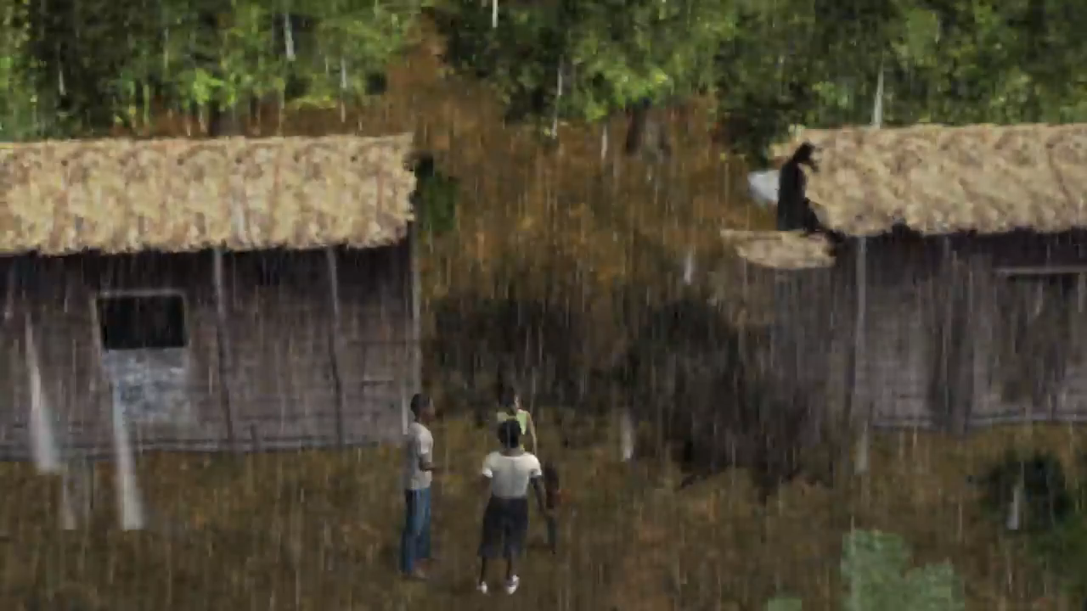
  What is a landslide?
  A landslide is the sudden movement of rock, soil, or debris down a slope due to gravity.
  It is often triggered by heavy rainfall or seismic activity and can cause damage to people and infrastructure.
  Landslide mapping is an essential task that enforces disaster risk reduction efforts.

Slide 3




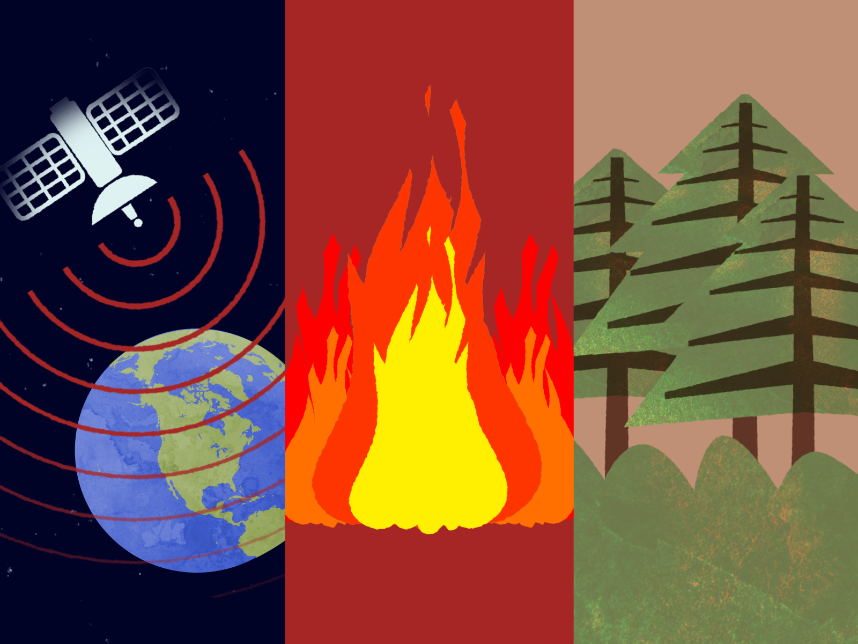
    Google Earth Engine(GEE)
    What is GEE?
    It is a cloud-based geospatial analysis platform that allows users to perform satellite image processing and remote sensing analysis.
    Applications
      Analysis of natural disasters
      Remote sensing researches

Slide 4
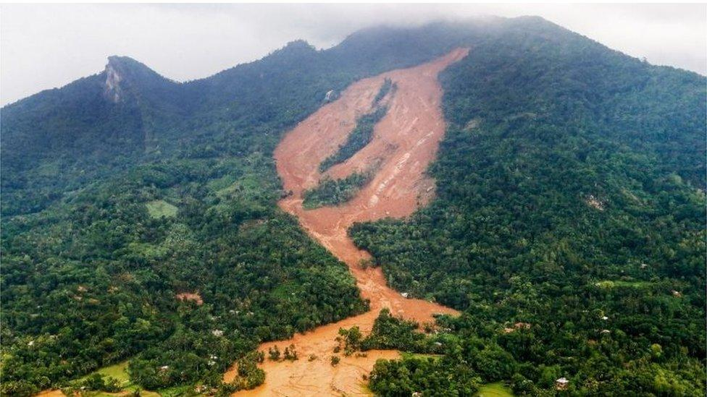
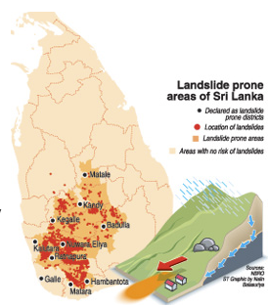
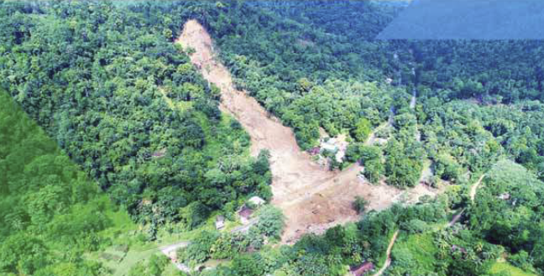
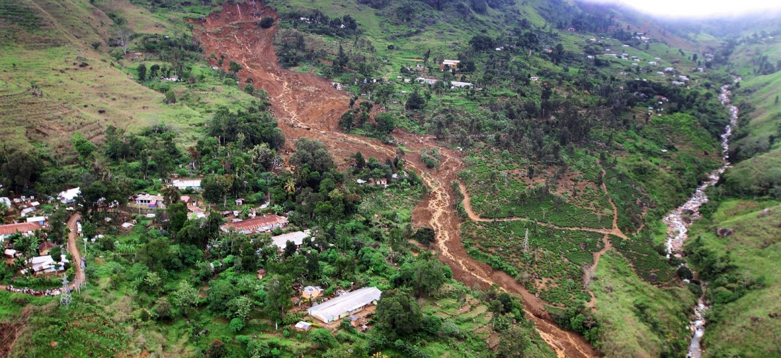
  In Sri Lanka,
  Climate → tropical
  Landslides → frequent natural hazard
  Significant events
Date:17/05/2016
Location: Aranayake
Death:127
  National Building Research Organization
    Rely on manual mapping
    Do not maintain an updated landslide database
    Often miss remote events
  National Building Research Organization
Date:29/10/2014
Location: Haldummulla
Death:16
Missing 192
  Importance of the study,
    Limited research exists on using satellite data and machine learning together for detecting landslides.
Date: 26/05/2017
Location: Athweltota
Death: 09

Slide 5
  Aim
To detect landslides in the study area using freely available satellite images on Google Earth Engine, integrating machine learning techniques.
  Objective
  To detect landslides using Sentinel-1 and Sentinel-2 images integrating machine learning on GEE, identify the best detection models for grids and the full area, and highlight key challenges.

Slide 6
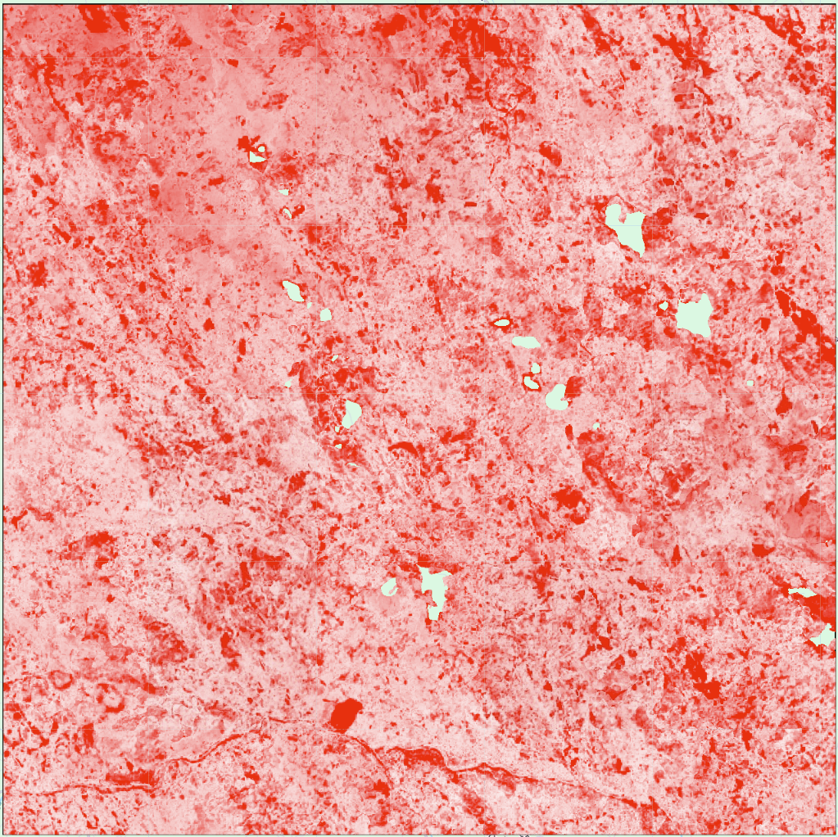
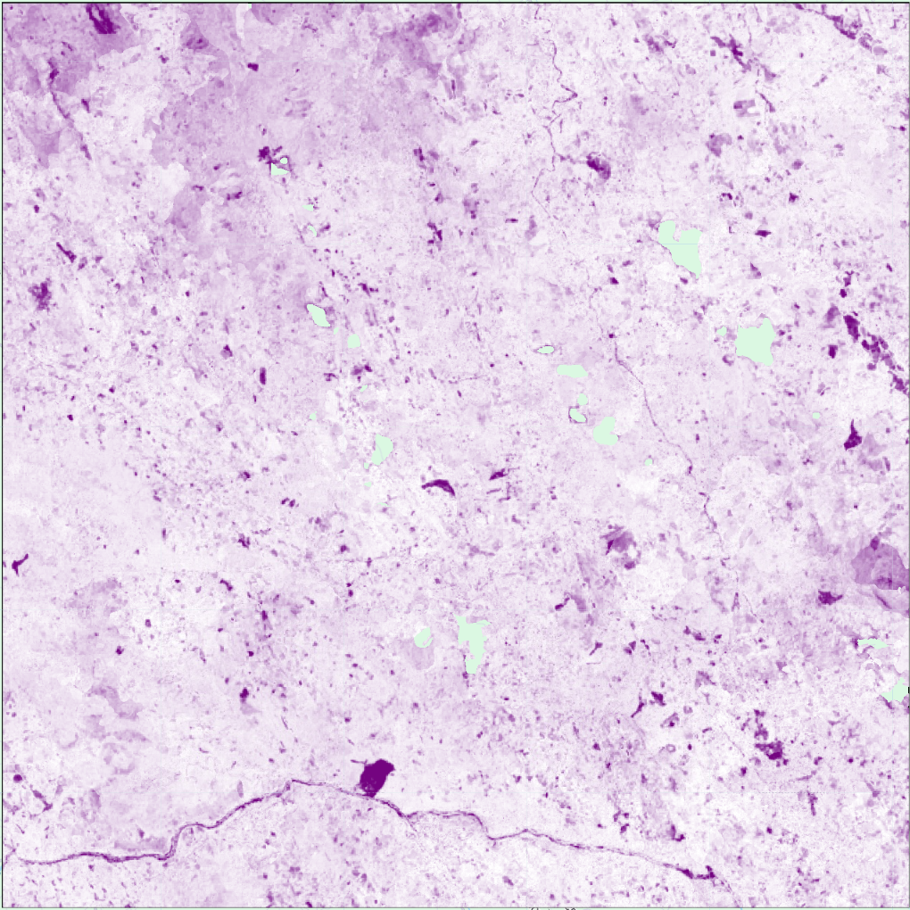
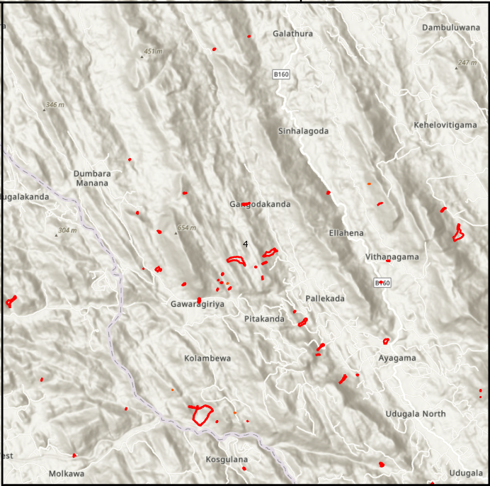
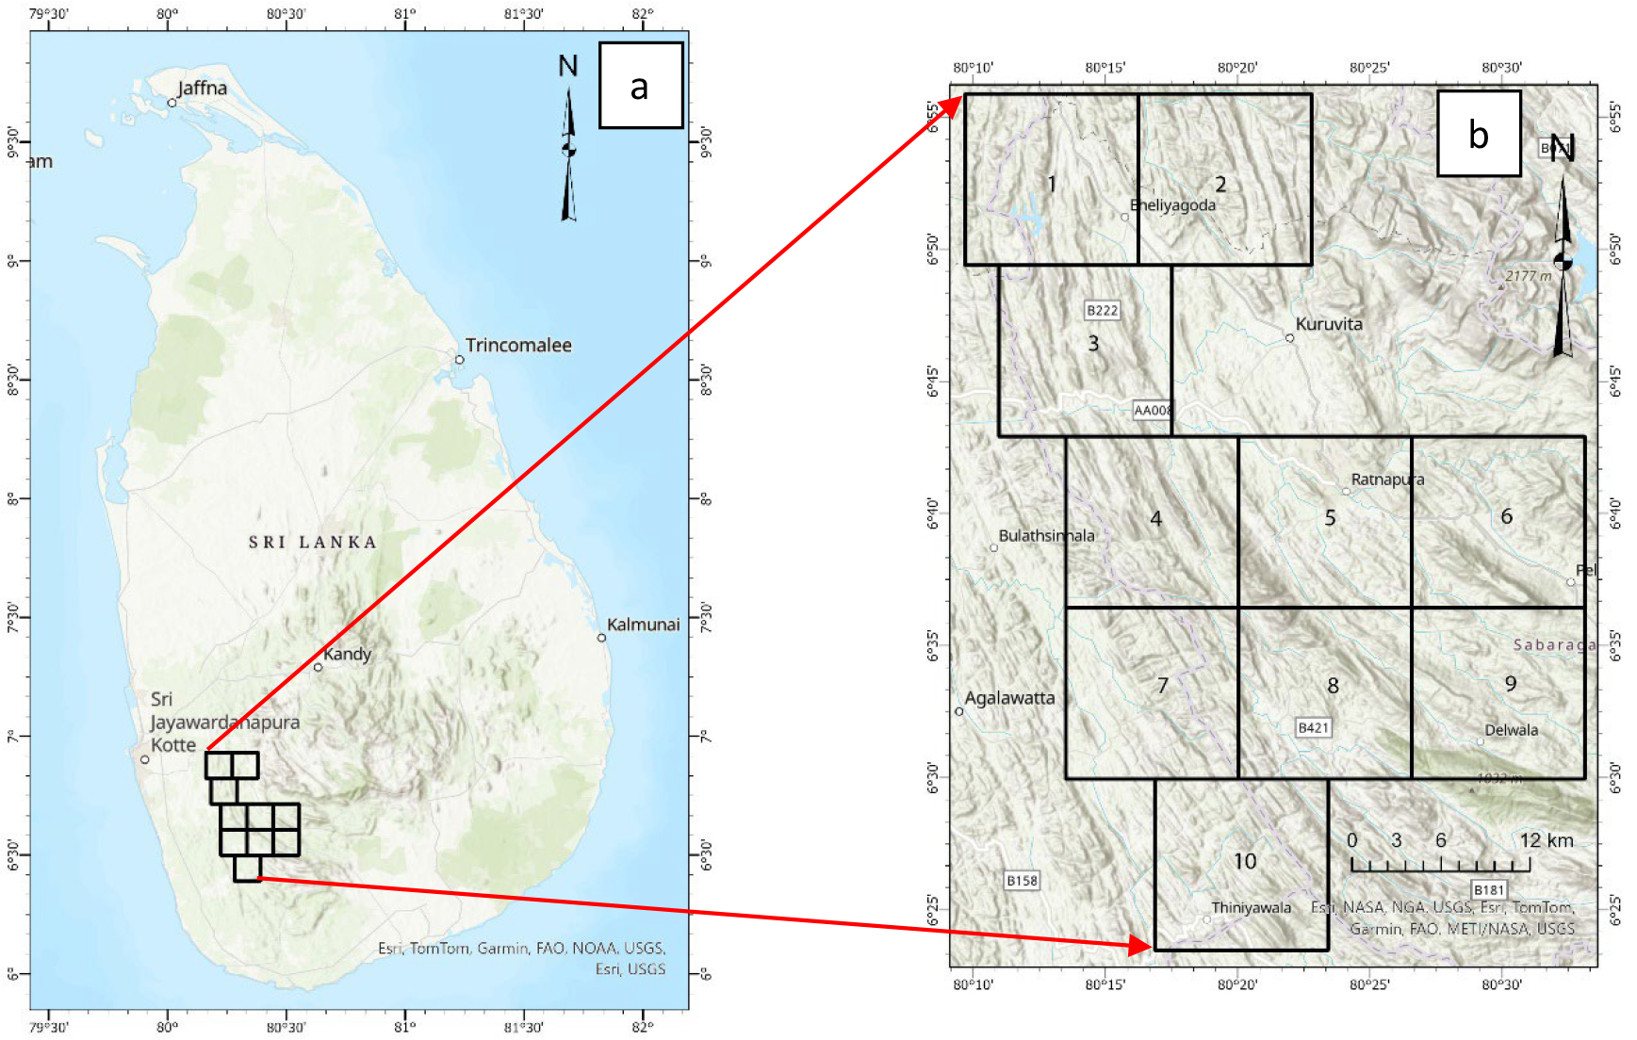
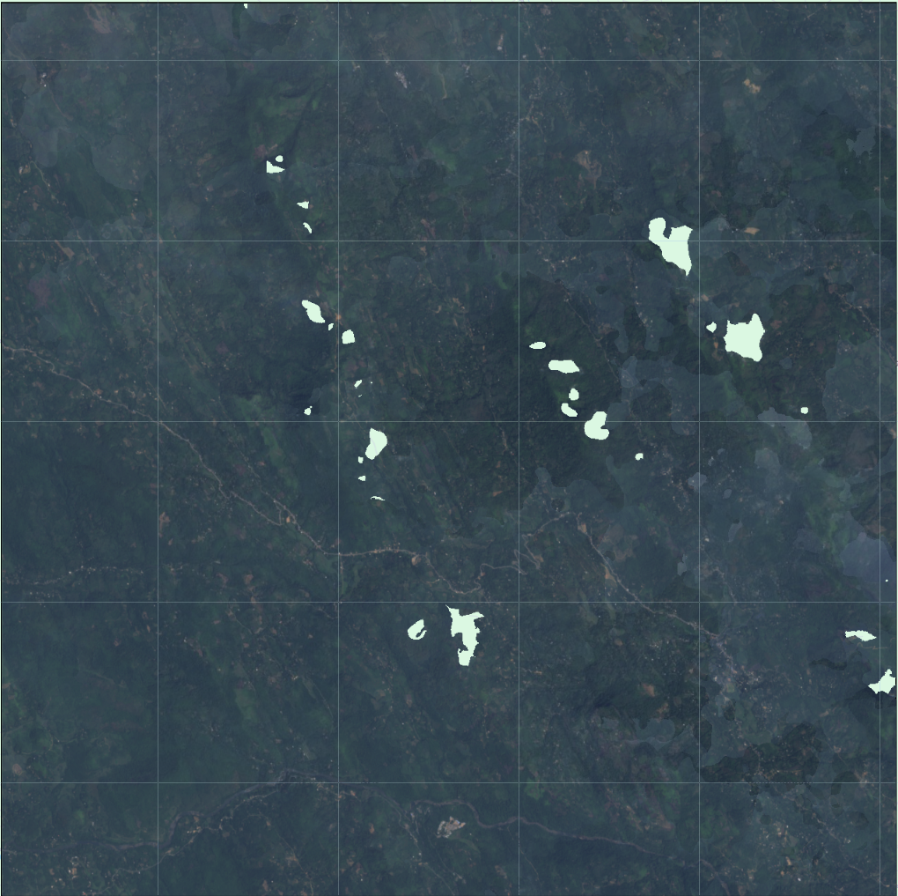
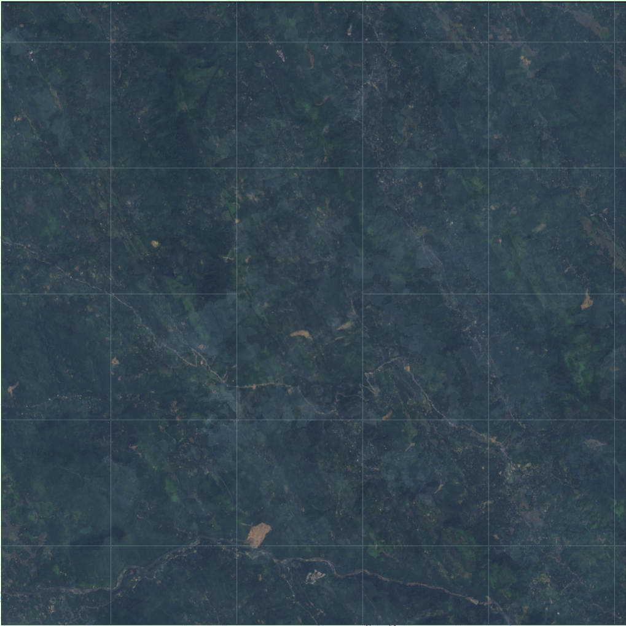
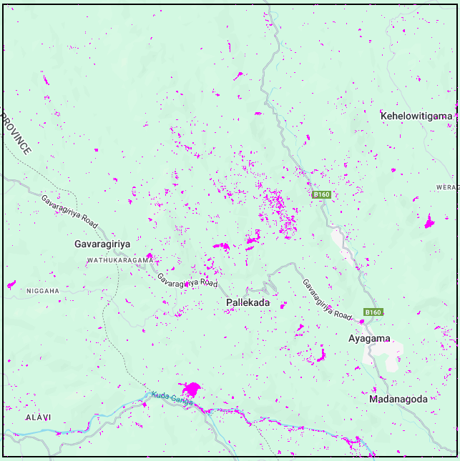
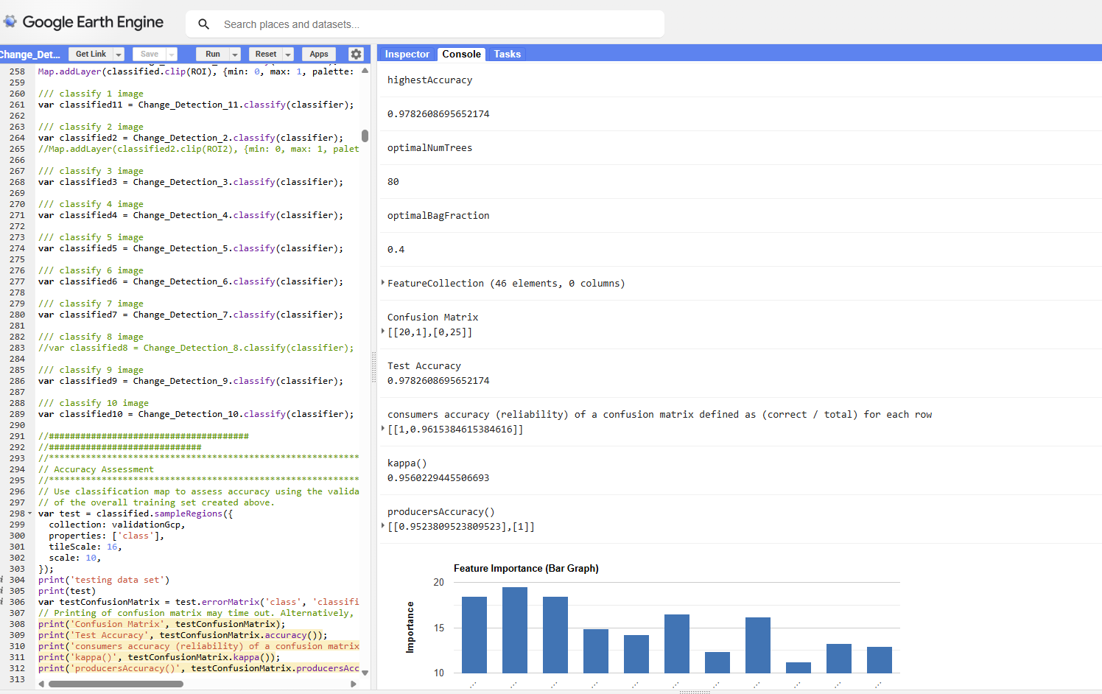
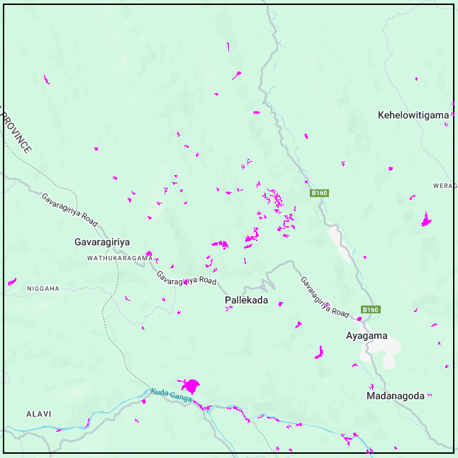
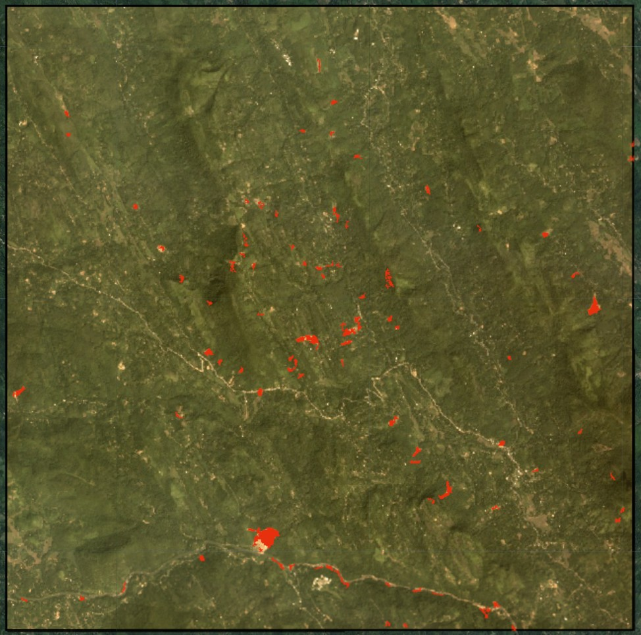
  Methodology
  Data collection and pre-processing
  Data collection and pre-processing
    Study area
    Historical events
    Satellite images
  Susceptibility modeling
  Susceptibility modeling
    Data preparation (Spectral indices, Topographic data, SAR data)
    Image classification
    Validation
  Landslide detections
  Landslide detections
    Post processing
    Validation of detections
  study area

Slide 7
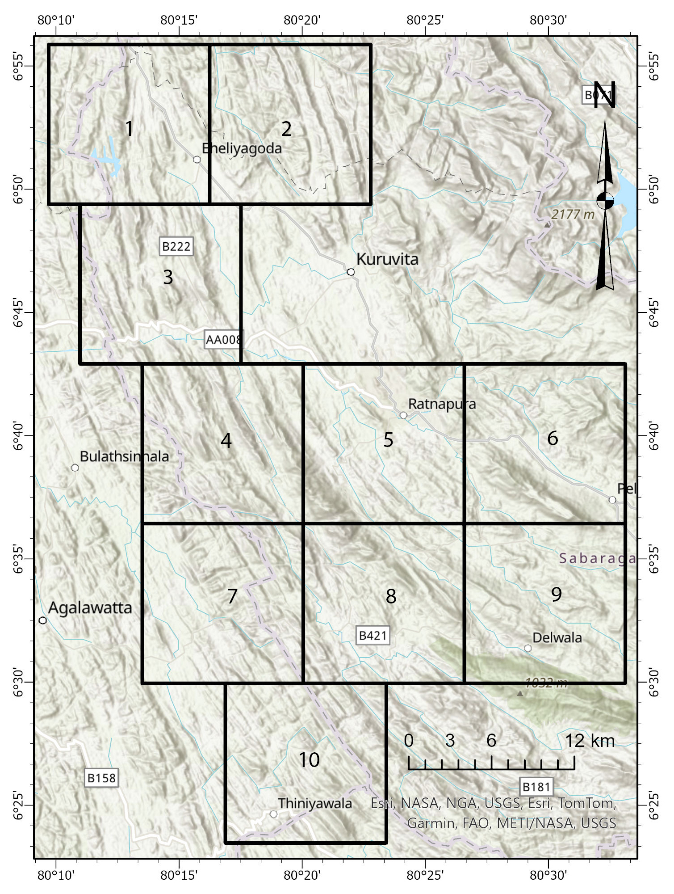
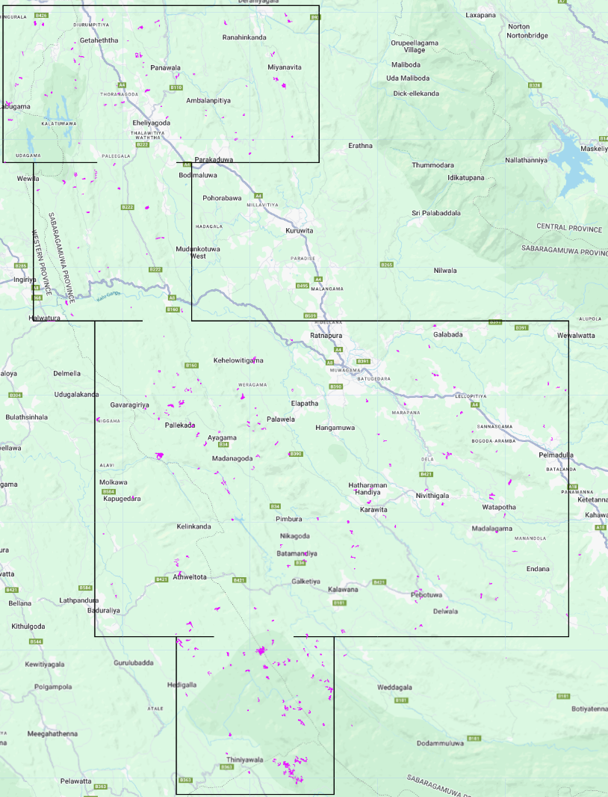
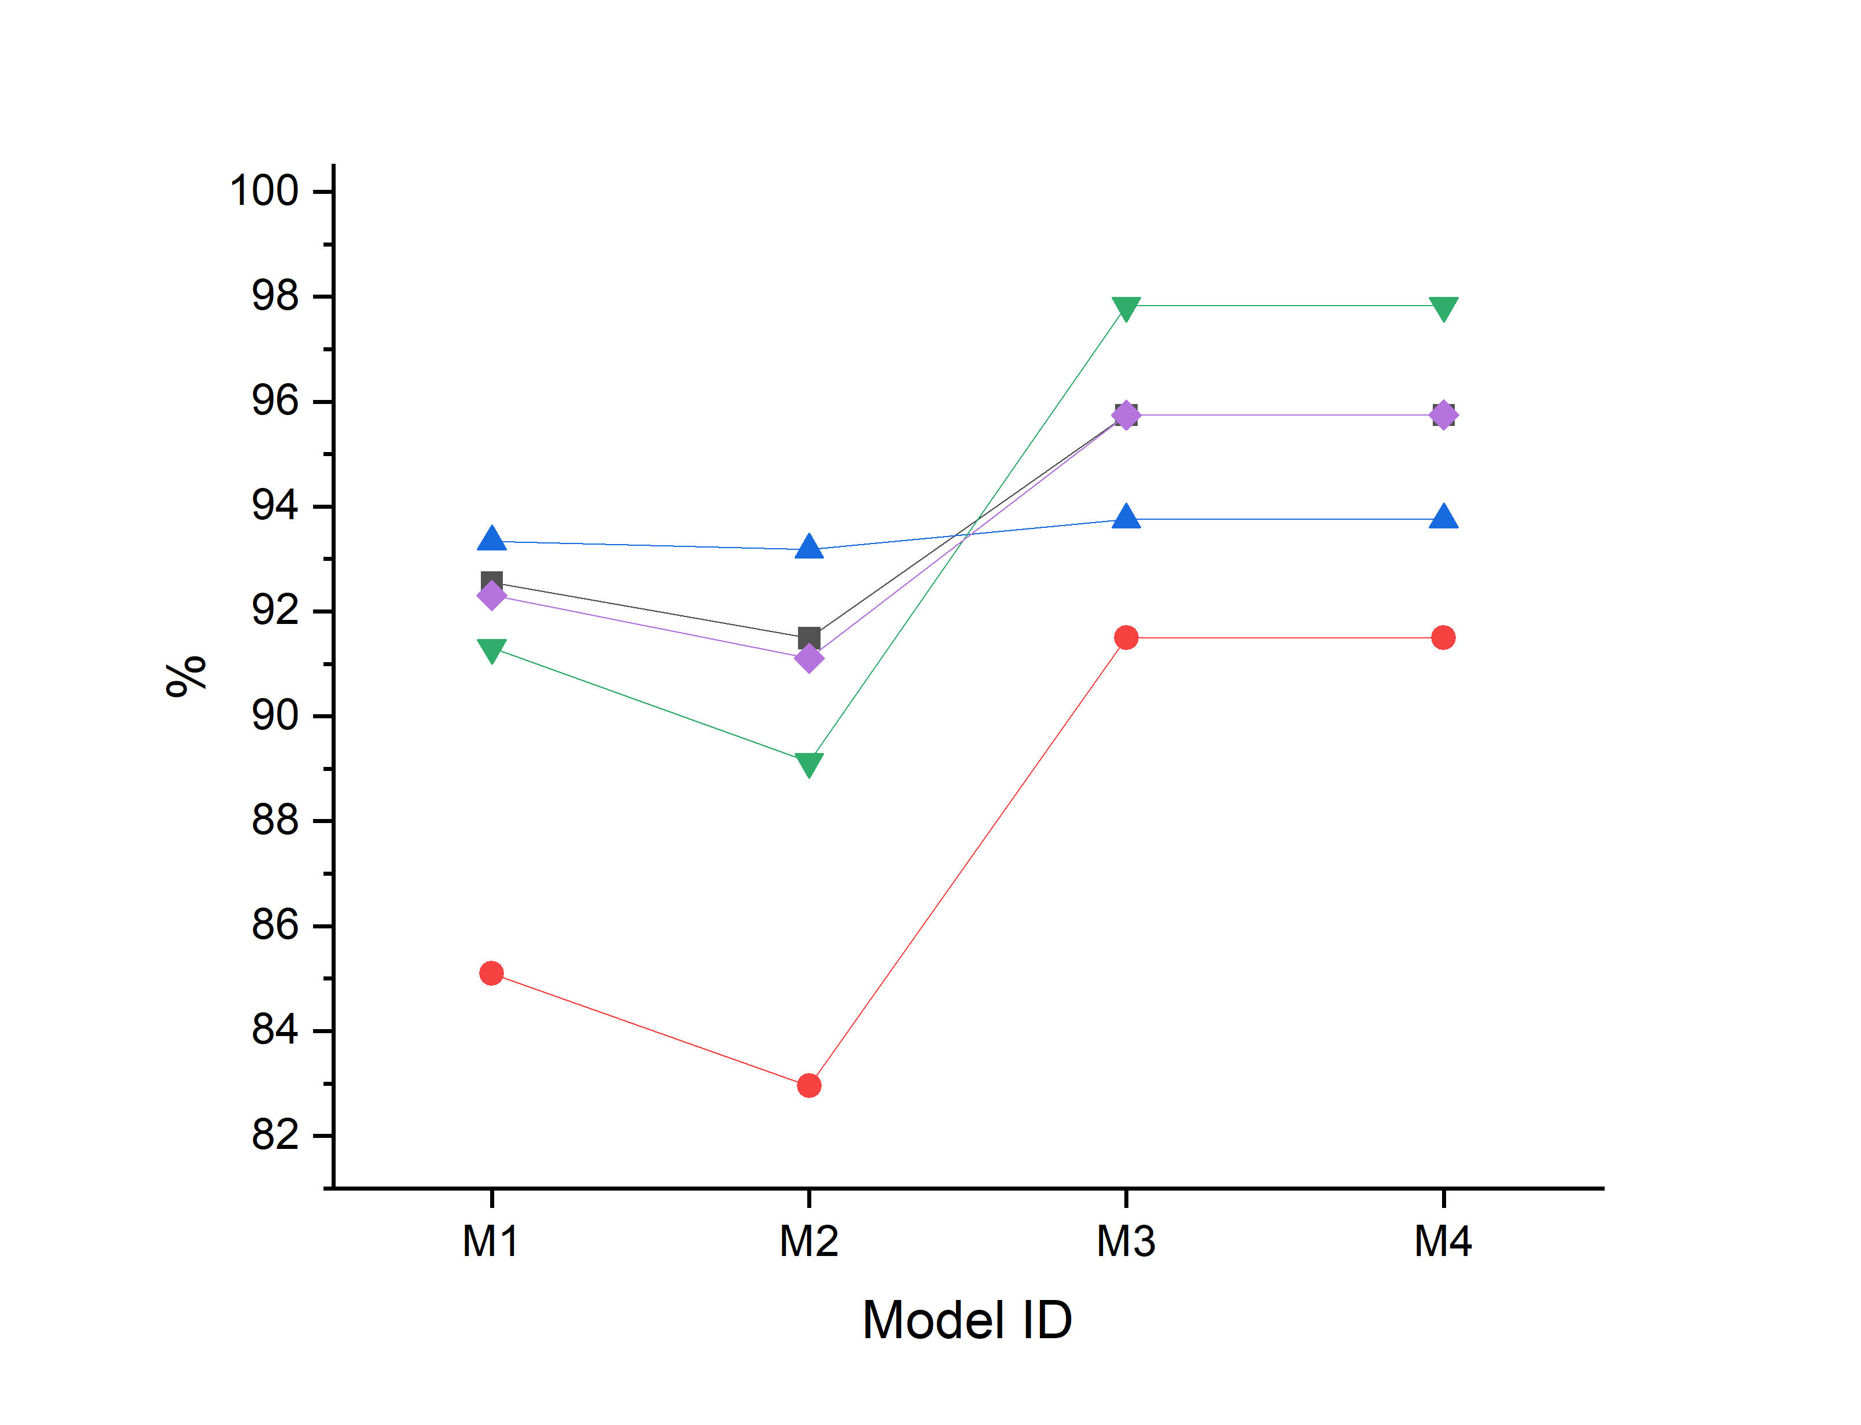
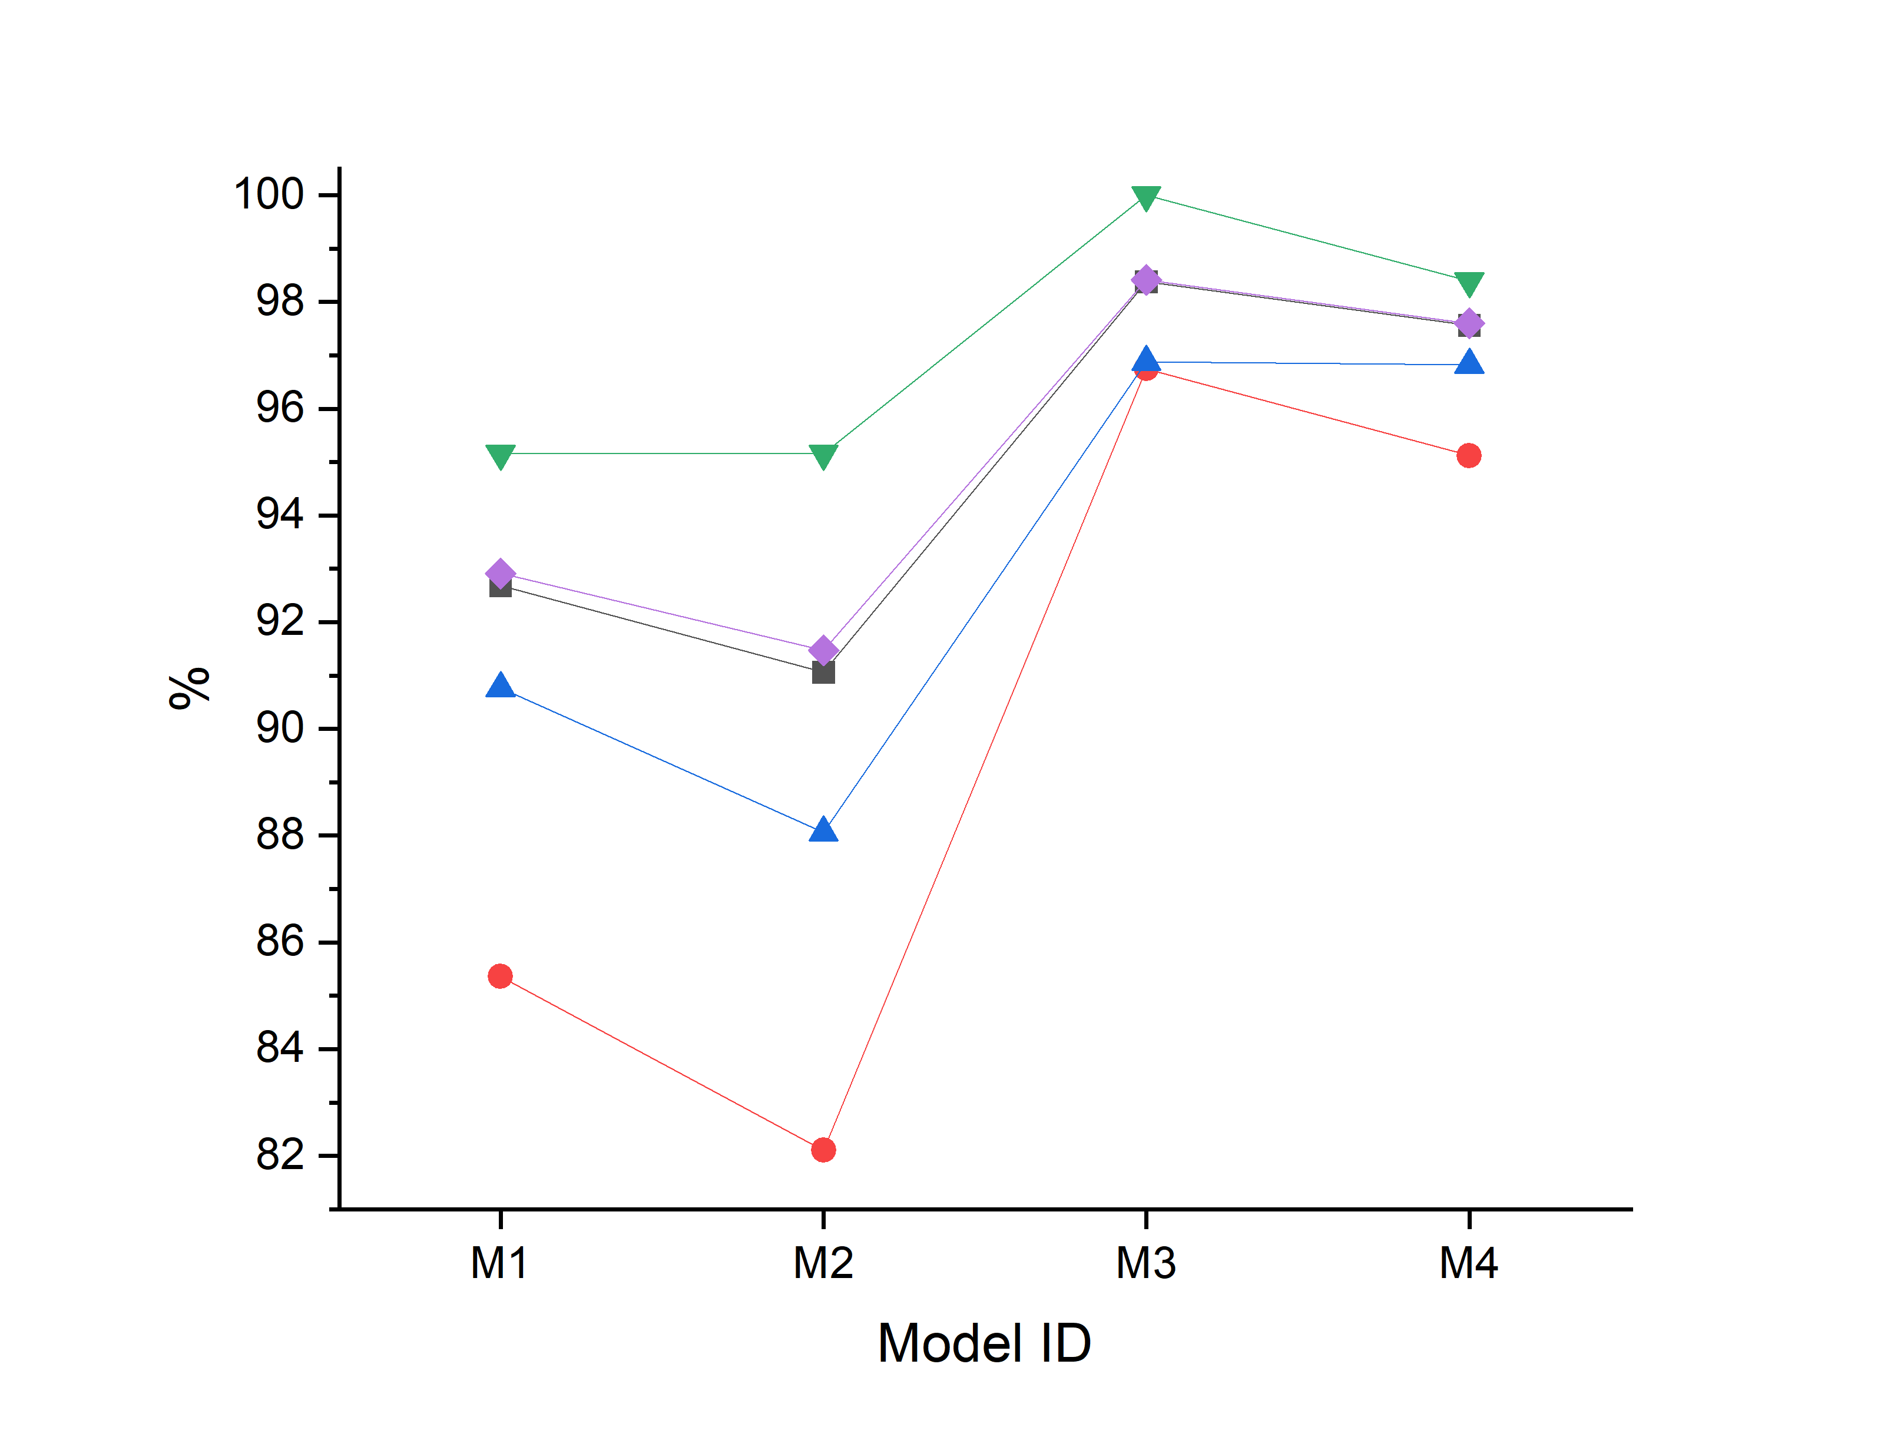
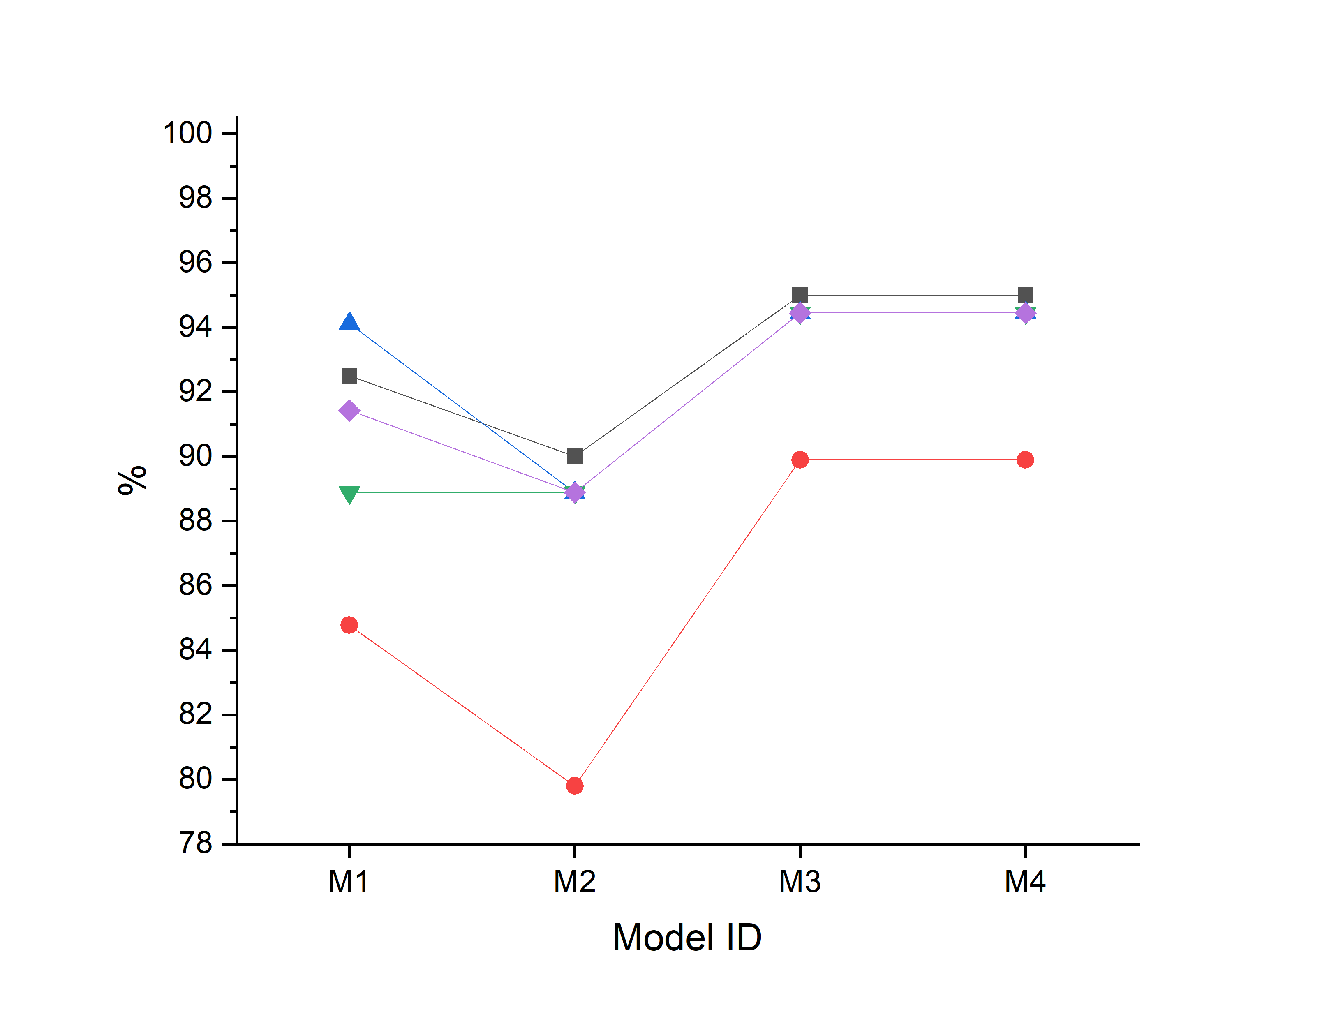
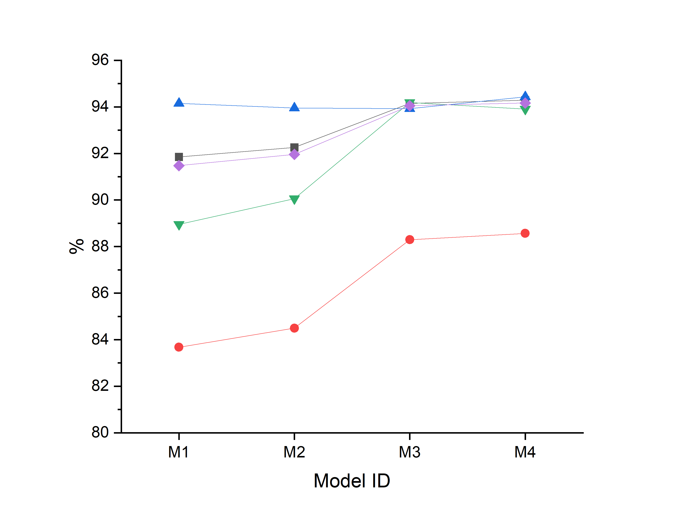
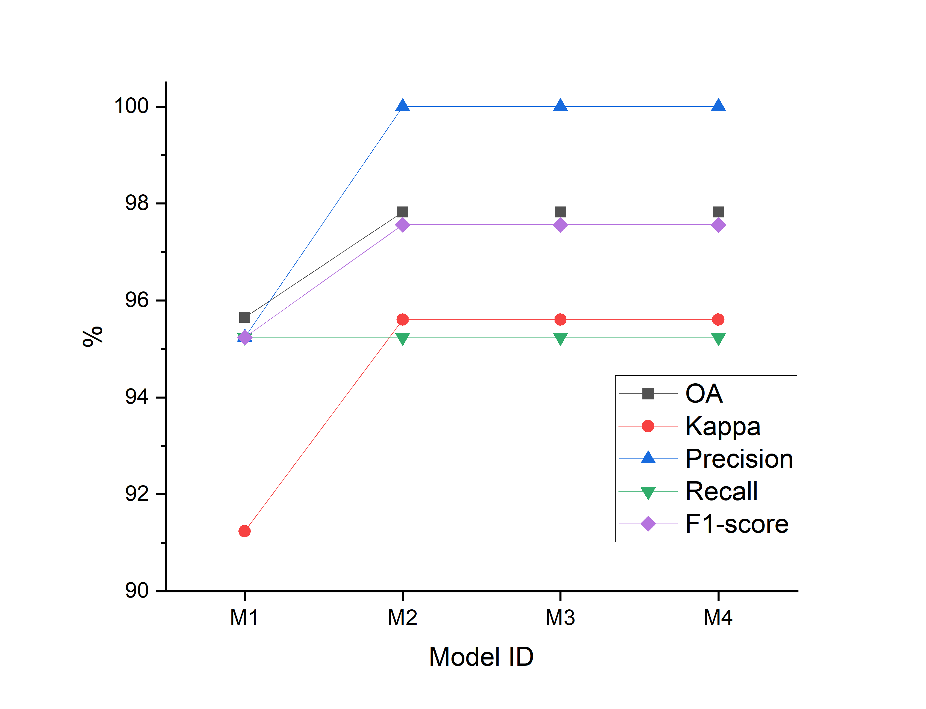
Results
Landslide detection of the area
  Individual grid-based analysis
  Whole-area analysis
  Individual grid-based analysis
              Whole-area analysis
M1: contains spectral_index differences
M2: included spectral distance and spectral angle
M3: incorporated topographic attributes
M4: combined all previous datasets with SAR amplitude ratio bands
Both approaches achieved optimum detections after adding topographic features to the modelling process.
Although the whole-area approach provided an efficient solution, individual grid models showed slightly higher accuracy and practical solution.

Slide 8
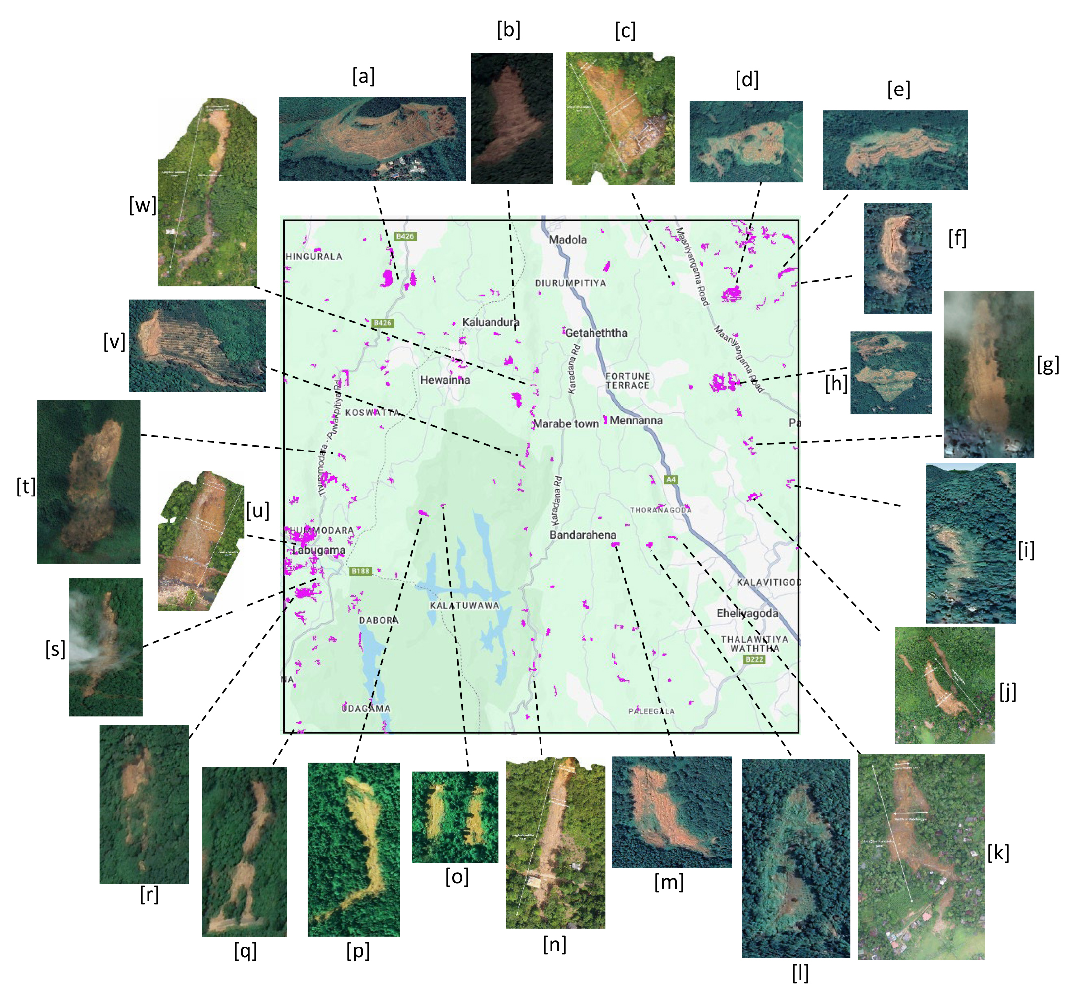
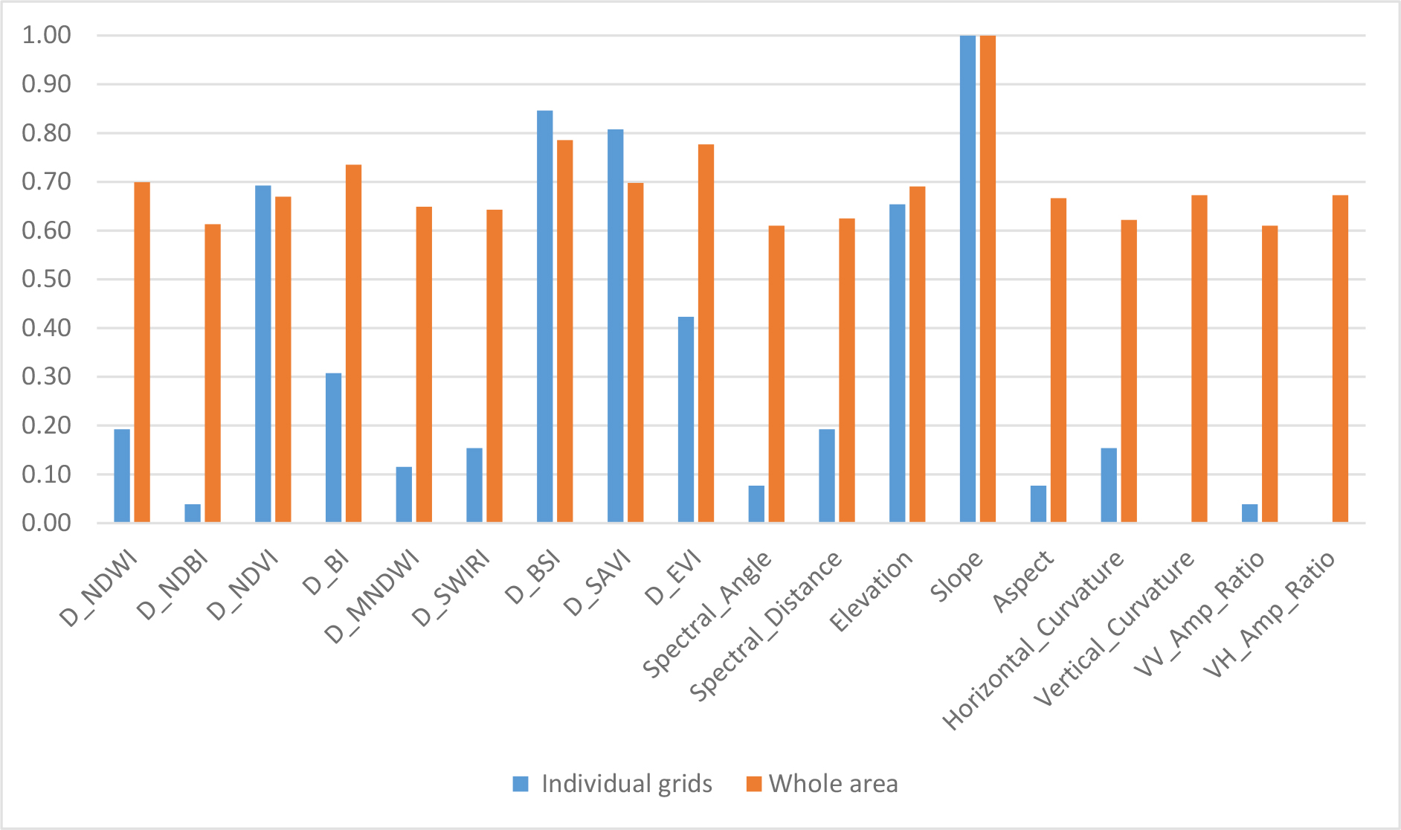
  Landslide detection
Pixel-based landslide susceptibility modelling and landslide detections
  Landslide detection
Importance of parameters in ML-based classification
    optimal models detected over 95% of historical events.
  Parameter importance
  Parameter importance
    Slope
    differential_bare_soil_index
Challenges of the study
  Cloud Score+ algorithm in GEE
  median composites images
Cloud Contamination
Cloud Contamination
False Positives in Agricultural Lands
  Integration of Land use/land cover maps
  object-based image analysis(OBIA)

Slide 9
Conclusions
Landslides can be accurately detected using free satellite imagery and machine learning methods on Google Earth Engine (GEE) in Sri Lanka, and this approach is also applicable to resource-limited regions worldwide.
Grid-based models demonstrated slightly higher accuracy, while whole-area models were more efficient and scalable.
Slope and Differential Bare Soil Index (DBSI) were the most influential factors in machine learning-based satellite image classification for landslide detection.
Cloud contamination and false detection in agricultural areas were key challenges.
A manuscript containing these findings has been submitted to the Journal of Earth System Science and is currently under peer review.

Slide 10
Thank You

