Slide 1


Image Processing Part
Using citizen science data as an approach to make low-cost and safe monitoring programmes in landslide zones: Cape Kidnappers and Taranaki North Cliffs case studies

Slide 2
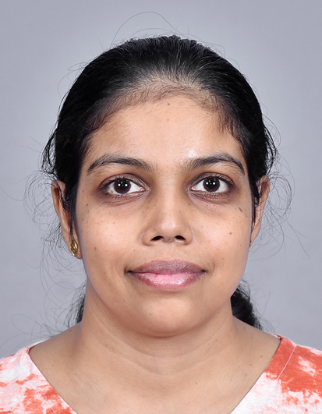
Introduction
Name: Dilhani Dodangoda
Qualification: Master of Philosophy Engineering
Institute: Auckland University of Technology (AUT)

Slide 3
Project Background
Coastal cliffs are vulnerable to erosion and landslides
Monitoring is important for safety and environmental management
Traditional methods are time-consuming and costly
Image processing offers a faster, low-cost alternative

Slide 4
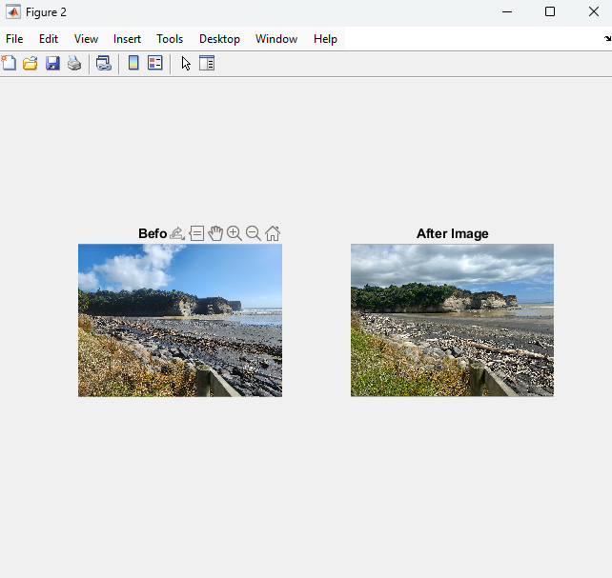
Aim and Objectives
Aim: Detect changes in cliff areas caused by landslides using image processing
Objectives:
Preprocess and standardize images
Align and compare before/after images
Apply noise reduction
Focus on cliff area using ROI
Detect and highlight significant changes

Slide 5
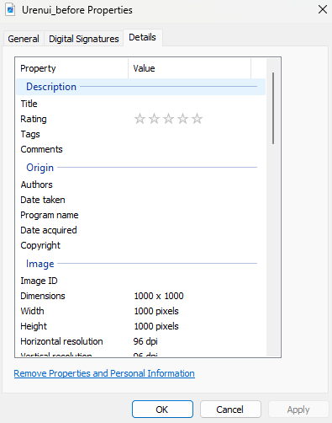
Image Preprocessing and Greyscale Conversion
Load before and after images (PNG format).
Resize to 1000 x 1000 pixels using down sampling.
Convert images to grayscale.

Slide 6
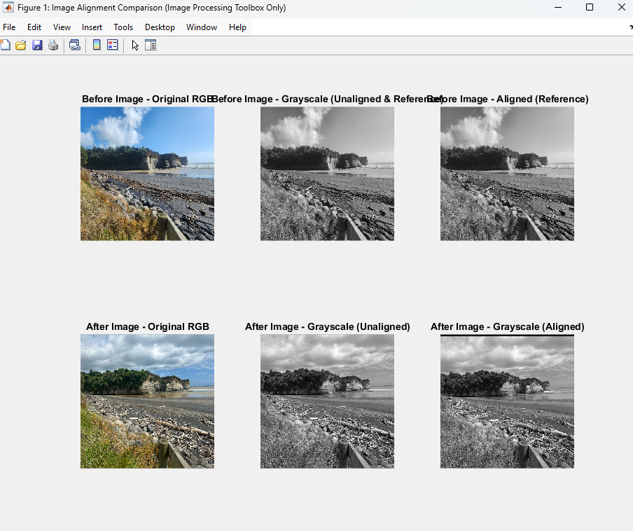
Alignment and Filtering
Align images using feature matching
Visual alignment
Apply Gaussian filter for noise reduction

Slide 7
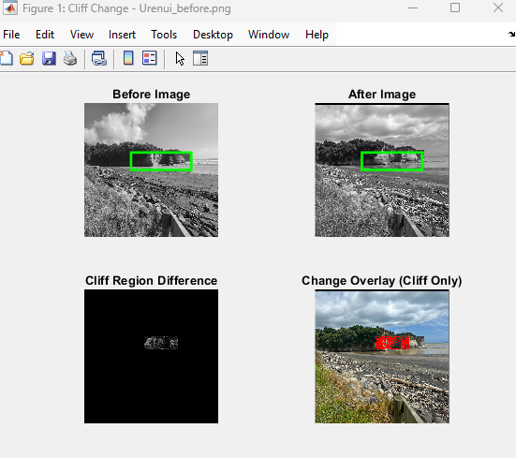
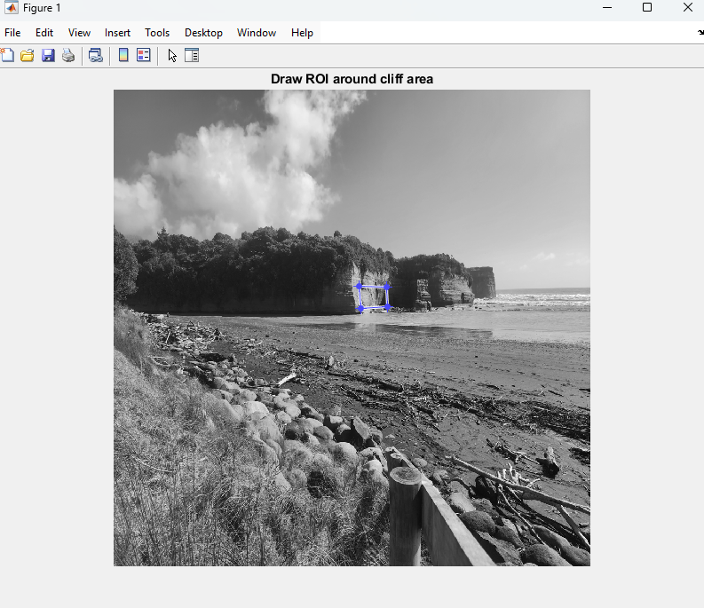
Define Region of Interest (ROI)
ROI Manually: Manual ROI selection involves interactively drawing a polygon over the cliff area in MATLAB.
ROI Automatically: Automatic ROI selection defines a fixed rectangular region using known pixel coordinates corresponding to the cliff area.

Slide 8
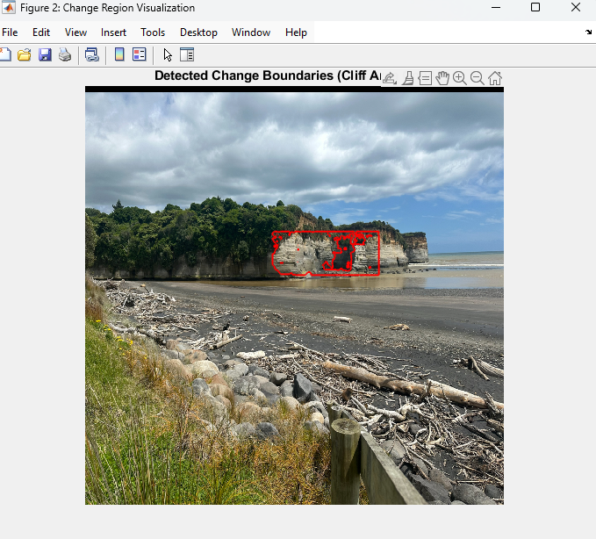
Final Output – Detected Changes
Display difference image with red outlines
Change detection done inside ROI
Thresholding used to filter minor changes

Slide 9
Limitations and Future Work
Limitations:
Manual ROI is time-consuming
Lighting differences may affect accuracy
Future Improvements:
Automate ROI selection with machine learning
Use multispectral or 3D data for deeper analysis
Batch process multiple image sets

Slide 10
Conclusion and Thanks
Method accurately detected cliff changes
Alignments and filters improved detection
Special thanks to Prof. Raj Prasanna for giving me the opportunity to contribute to this research project.
Sincere appreciation to Mr. Alfredo (PhD student) for providing the project details and access to the images database.

